Slide 1
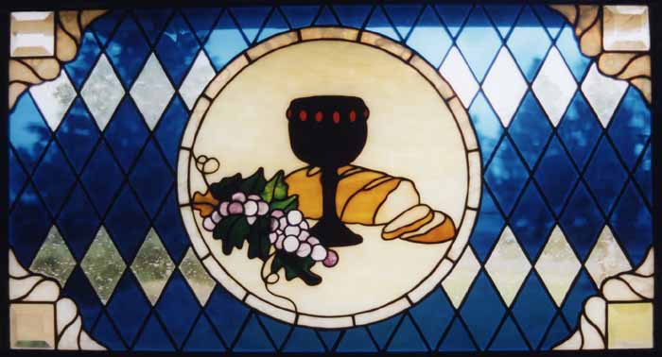

Slide 2
Most merciful God, we confess that we have sinned against you in thought, word, and deed, by what we have done, and by what we have left undone.

Slide 3
We have not loved you with our whole heart; we have not loved our neighbors as ourselves.

Slide 4
We are truly sorry and we humbly repent.

Slide 5
For the sake of your Son Jesus Christ, have mercy on us and forgive us; that we may delight in your will, and walk in your ways, to the glory of your name. Amen.

Slide 7
I believe in God, the Father Almighty,
creator of heaven and earth.
I believe in Jesus Christ, God’s only Son, our Lord,
who was conceived by the Holy Spirit,
born of the Virgin Mary,
suffered under Pontius Pilate,

Slide 8
was crucified, died, and was buried;
he descended to the dead.
On the third day he rose again;
he ascended into heaven,
is seated at the right hand of the Father,
and will come again to judge the living and the dead.

Slide 9
I believe in the Holy Spirit,
the holy Christian Church,
the communion of saints,
the forgiveness of sins,
the resurrection of the body,
and the life everlasting. Amen.

Slide 11
Our Father, who art in heaven,
hallowed by thy name.
Thy kingdom come, thy will be done,
on earth as it is in heaven.

Slide 12
Give us this day our daily bread.
And forgive us our sins,
as we forgive those that sin against us.
And lead us not into temptation,
but deliver us from evil.

Slide 13
For thine is the kingdom,
the power and the glory,
forever and ever. Amen.

Slide 15


Slide 16
19 Consequently, you are no longer foreigners and aliens, but fellow citizens with God's people and members of God's household, 20 built on the foundation of the apostles and prophets, with Christ Jesus himself as the chief cornerstone. 21 In him the whole building is joined together and rises to become a holy temple in the Lord. 22 And in him you too are being built together to become a dwelling in which God lives by his Spirit.

Slide 18
Do you believe the Bible to be the word of God and the only perfect rule for faith, doctrine, and conduct?
Do you confess Jesus Christ as your Savior and Lord?

Slide 19
Do you promise to remain steadfast in faith?
Do you promise to live a life that is morally and ethically consistent with the example and teachings of Jesus Christ?
Do you promise to devote yourself to the task of growing spiritually?
Do you promise to worship regularly in this church?
Do you intend to live among God’s faithful people, to hear his word and share in his supper, to proclaim the good news of God in Christ through word and deed, and to strive for justice and peace in all the earth?
Do you promise to give your time, talents and treasure for the work of the gospel as carried on by this church and the denomination to which it belongs?

Slide 20
Do you promise to remain steadfast in faith?
Do you promise to live a life that is morally and ethically consistent with the example and teachings of Jesus Christ?
Do you promise to devote yourself to the task of growing spiritually?
Do you promise to worship regularly in this church?
Do you intend to live among God’s faithful people, to hear his word and share in his supper, to proclaim the good news of God in Christ through word and deed, and to strive for justice and peace in all the earth?
Do you promise to give your time, talents and treasure for the work of the gospel as carried on by this church and the denomination to which it belongs?

Slide 21
Do you promise to remain steadfast in faith?
Do you promise to live a life that is morally and ethically consistent with the example and teachings of Jesus Christ?
Do you promise to devote yourself to the task of growing spiritually?
Do you promise to worship regularly in this church?
Do you intend to live among God’s faithful people, to hear his word and share in his supper, to proclaim the good news of God in Christ through word and deed, and to strive for justice and peace in all the earth?
Do you promise to give your time, talents and treasure for the work of the gospel as carried on by this church and the denomination to which it belongs?

Slide 22
Do you promise to remain steadfast in faith?
Do you promise to live a life that is morally and ethically consistent with the example and teachings of Jesus Christ?
Do you promise to devote yourself to the task of growing spiritually?
Do you promise to worship regularly in this church?
Do you intend to live among God’s faithful people, to hear his word and share in his supper, to proclaim the good news of God in Christ through word and deed, and to strive for justice and peace in all the earth?
Do you promise to give your time, talents and treasure for the work of the gospel as carried on by this church and the denomination to which it belongs?

Slide 23
Do you promise to remain steadfast in faith?
Do you promise to live a life that is morally and ethically consistent with the example and teachings of Jesus Christ?
Do you promise to devote yourself to the task of growing spiritually?
Do you promise to worship regularly in this church?
Do you intend to live among God’s faithful people, to hear his word and share in his supper, to proclaim the good news of God in Christ through word and deed, and to strive for justice and peace in all the earth?
Do you promise to give your time, talents and treasure for the work of the gospel as carried on by this church and the denomination to which it belongs?

Slide 24
Do you promise to remain steadfast in faith?
Do you promise to live a life that is morally and ethically consistent with the example and teachings of Jesus Christ?
Do you promise to devote yourself to the task of growing spiritually?
Do you promise to worship regularly in this church?
Do you intend to live among God’s faithful people, to hear his word and share in his supper, to proclaim the good news of God in Christ through word and deed, and to strive for justice and peace in all the earth?
Do you promise to give your time, talents and treasure for the work of the gospel as carried on by this church and the denomination to which it belongs?

