Slide 1
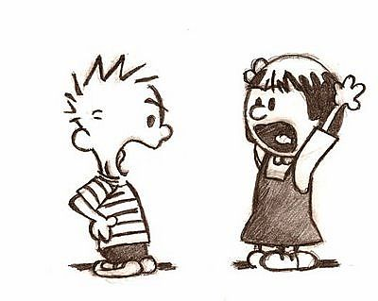
Fights at the Line James 4

Slide 2
1 What causes fights and quarrels among you? Don't they come from your desires that battle within you? 2 You want something but don't get it. You kill and covet, but you cannot have what you want. You quarrel and fight. You do not have, because you do not ask God. 3 When you ask, you do not receive, because you ask with wrong motives, that you may spend what you get on your pleasures.4 You adulterous people, don't you know that friendship with the world is hatred toward God? Anyone who chooses to be a friend of the world becomes an enemy of God.

Slide 3
5 Or do you think Scripture says without reason that the spirit he caused to live in us envies intensely? 6 But he gives us more grace. That is why Scripture says:"God opposes the proud but gives grace to the humble."7 Submit yourselves, then, to God. Resist the devil, and he will flee from you. 8 Come near to God and he will come near to you. Wash your hands, you sinners, and purify your hearts, you double- minded.

Slide 4
9 Grieve, mourn and wail. Change your laughter to mourning and your joy to gloom. 10 Humble yourselves before the Lord, and he will lift you up.11 Brothers, do not slander one another. Anyone who speaks against his brother or judges him speaks against the law and judges it. When you judge the law, you are not keeping it, but sitting in judgment on it. 12 There is only one Lawgiver and Judge, the one who is able to save and destroy. But you–who are you to judge your neighbor?

Slide 5
Fights at the Line James 4

Slide 6
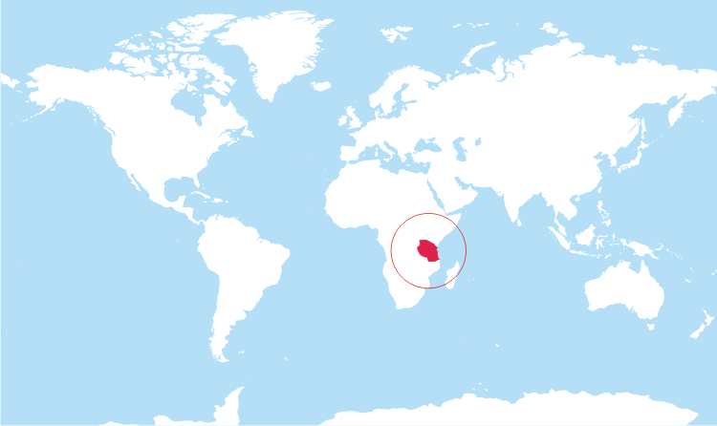
Dr. Dave and Sarah Halter
Daniel (5) & Micah (2)
Training, mentoring, and discipling Tanzanian surgeons while providing surgical care to the poor.
Arusha, Tanzania

Slide 7
We rejoice that God has led you to this moment. We stand to express our gratitude to God for you. While you are serving, we too shall serve by our prayers, concern, and support. May God bless you as you go, and us as we also seek to respond to God’s calling here at home.

