Slide 3
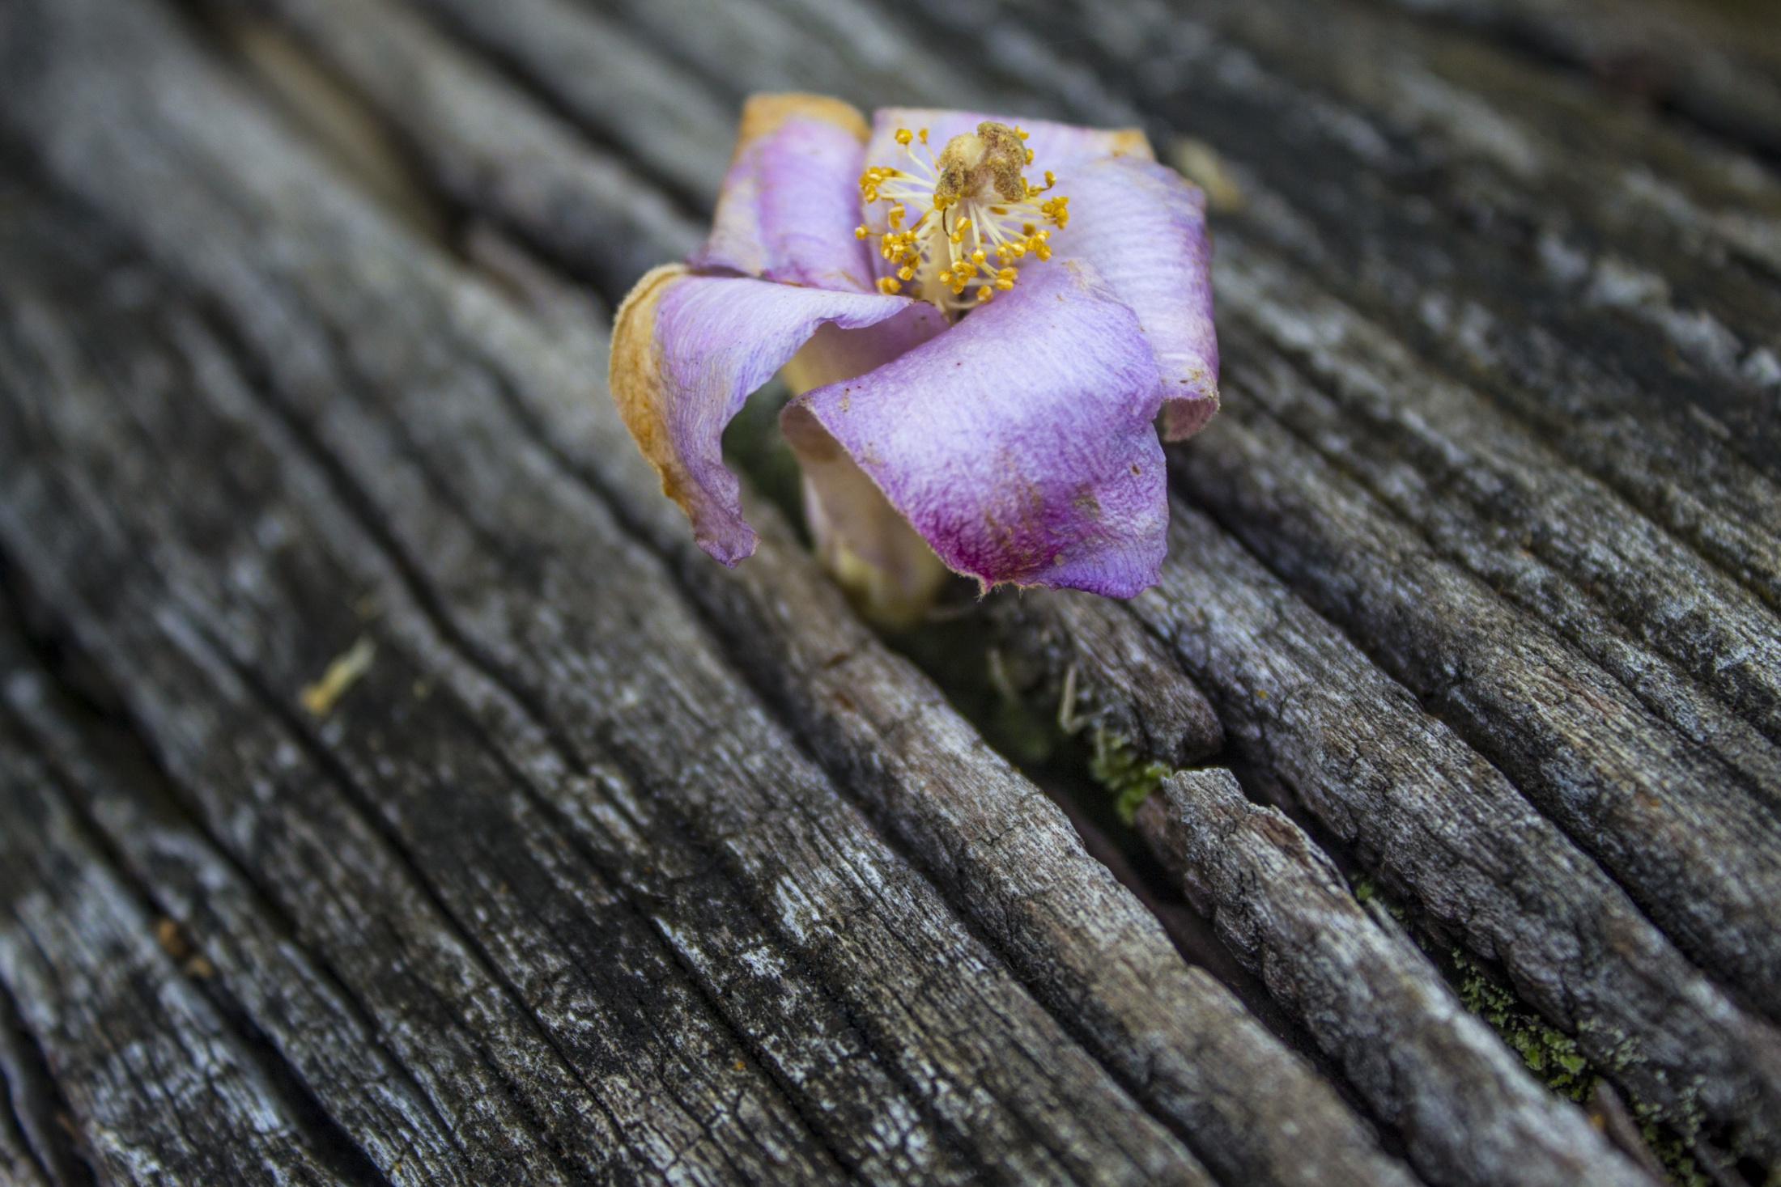

Slide 4
Job 14:7-15
“At least there is hope for a tree: If it is cut down, it will sprout again, and its new shoots will not fail. Its roots may grow old in the ground and its stump die in the soil, yet at the scent of water it will bud and put forth shoots like a plant.

Slide 5
But man dies and is laid low; he breathes his last and is no more. As water disappears from the sea or a riverbed becomes parched and dry, so man lies down and does not rise; till the heavens are no more, men will not awake or be roused from their sleep.

Slide 6
“If only you would hide me in the grave and conceal me till your anger has passed! If only you would set me a time and then remember me! If a man dies, will he live again? All the days of my hard service I will wait for my renewal to come. You will call and I will answer you; you will long for the creature your hands have made.

Slide 8
Job 19:23-27
“Oh, that my words were recorded, that they were written on a scroll, that they were inscribed with an iron tool on lead, or engraved in rock forever! I know that my Redeemer lives, and that in the end he will stand upon the earth. And after my skin has been destroyed, yet in my flesh I will see God; I myself will see him with my own eyes–I, and not another. How my heart yearns within me!

Slide 10
Images of Atonement

Slide 11
Images of Atonement
Temple Worship

Slide 12
Images of Atonement
Temple Worship
Market Place

Slide 13
Images of Atonement
Temple Worship
Market Place
Law Court

Slide 14
Images of Atonement
Temple Worship
Market Place
Law Court
Battlefield

Slide 18
Empathy

Slide 19
Empathy
Perspective taking

Slide 20
Empathy
Perspective taking
Staying out of judgment

Slide 21
Empathy
Perspective taking
Staying out of judgment
Recognizing emotion in other people

Slide 22
Empathy
Perspective taking
Staying out of judgment
Recognizing emotion in other people
Communicating recognition of other’s emotion

